Slide 1
Learning with Noisy Labels

Slide 2
Objective 1 : Comparison study
With Vision Transformer model on CIFAR dataset
Analyze the performance with noise as hyperparameter
Explore Cleanlab performance with/without noise on the same dataset

Slide 3
Resources
CIFAR Dataset: https://pytorch.org/vision/stable/generated/torchvision.datasets.CIFAR100.html
Vision Transformer:
https://pytorch.org/vision/main/models/vision_transformer.html
https://github.com/pytorch/vision/blob/main/torchvision/models/vision_transformer.py
Cleanlab: https://cleanlab.ai/blog/
CROWDLAB: Utilizing supervised models to infer consensus labels and their quality from data with multiple annotators
User Behavior : Mining Implicit Relevance Feedback from User Behavior for Web Question Answering
Federated Learning with Noisy User Feedback (Video)

Slide 4
CROWDLAB
Classifier Refinement Of croWDsourced LABels (CROWDLAB) can utilize any classifier to estimate:
A consensus label
A quality score for each consensus label
A quality score for each annotator
Utilizing supervised models to infer consensus labels and their quality from data with multiple annotators

Slide 5
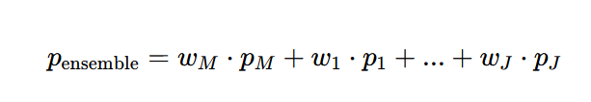
CROWDLAB
Consensus label:
Weights w_{M}, w₁,...,w_{j}​ are assigned according to an estimate of how trustworthy the model is vs. each individual annotator

Slide 6


CROWDLAB
Label Quality Score:
Used Self-confidence as label quality score

Slide 7
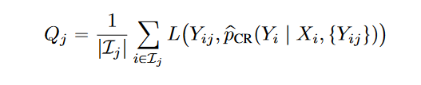
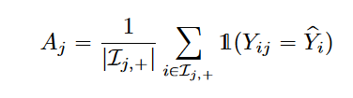
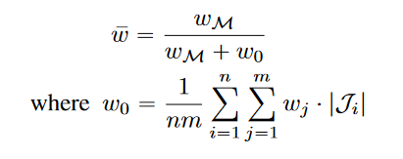

CROWDLAB
Annotator Quality Score:

Slide 8
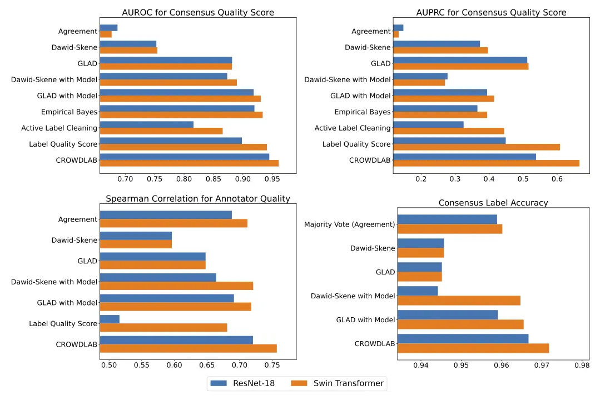
CROWDLAB

Slide 9
CROWDLAB
Other crowdsourcing algorithms use only annotator statistics, whereas CROWDLAB utilizes additional information provided by classifier, which could be beneficial when only few ( or one) labels are available for some examples.
For examples that received a large number of annotations, CROWDLAB assigns less relative weight to the classifier predictions and its consensus quality score converges toward the observed annotator agreement
CROWDLAB merely infers one scalar trustworthiness weight for each annotator, which can be better estimated from a limited number of observations.
CROWDLAB does not require iterative updates and is fully deterministic (for a given classifier)

Slide 10
User behavior
Straightforward : if the user clicks -> only a small fraction of users will provide their feedback though as it is not a mandate
Study:
a) clicking on the feedback links, < 0.001% of the total QA impressions.
b) users strongly tend to provide negative feedback – the positive over negative ratio is about 1:17.
c) To get balanced training dataset, we need to sample equal amounts of positive and negative examples from the skewed label distribution. This can reduce the size of valid training data that can be derived from explicit feedback, which may not be a good source to collect training data for web QA model.
Mining Implicit Relevance Feedback from User Behavior for Web Question Answering

Slide 11
User behavior
Indirect:
a) Reformulate the query : In a given session the sequence of user queries particularly note whether user issues a new query by modifying the previous one
b) Click behavior: i) Click on the search result ii) Click on more. iii) In SERP context: 1) which result on the page the user clicks 2) user clicks on the related queries to explore more.
c) Browsing behavior: User reads the content but does not give any input/feedback.

Slide 12
CROWD TRUTH
Usually inter-annotator disagreement is not captured, either because the number of annotators is too small to capture the full diversity of opinion, or because the crowd data is aggregated with metrics that enforce consensus, such as majority vote.
Crowd truth captures the ambiguity inherent in semantic annotation through the use of disagreement-aware metrics for aggregating crowdsourcing response
Models the inter-dependency between the three main components of a crowdsourcing system – worker, input data, and annotation

Slide 13
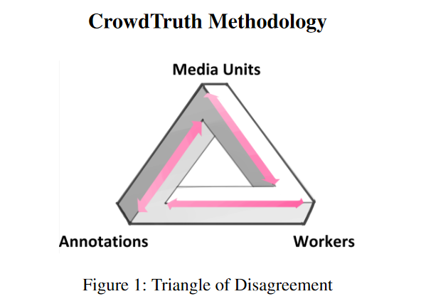
CROWD TRUTH
Disagreement caused by low quality workers should not be interpreted as the data being ambiguous, but also that ambiguous input data should not be interpreted as due to the low quality of the workers
The triangle model expresses how ambiguity in any of the corners disseminates and influences the other components of the triangle. For example, an unclear sentence or an ambiguous annotation scheme would cause more disagreement between workers and thus, both need to be accounted for when measuring the quality of the workers

Slide 14
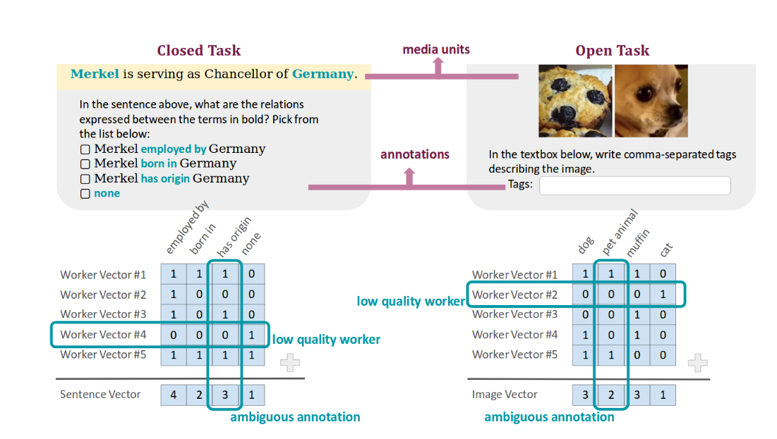
CROWD TRUTH

Slide 15
CROWD TRUTH
Media Unit Quality Score (UQS)
expresses the overall worker agreement over one media unit
Worker Quality Score (WQS)
measures the overall agreement of one crowd worker with the other workers
Annotation Quality Score (AQS)
measures the agreement over an annotation in all media units that it appears
Media Unit - Annotation Score (UAS)
the degree of clarity with which an annotation is expressed in a unit

Slide 16
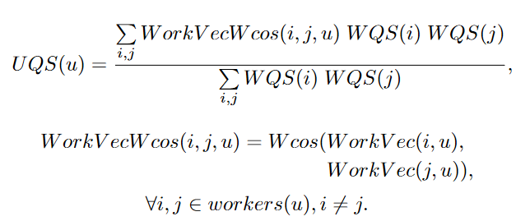
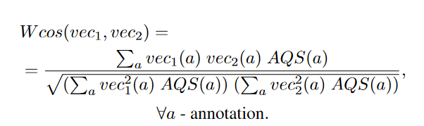
CROWD TRUTH
Media Unit Quality Score

Slide 17
CROWD TRUTH
Worker Quality Score (WQS)
WQS(i) = WWA(i) x WUA(i)
Worker-Worker Agreement (WWA)
For a given worker i, measures the average pairwise agreement between i and all other workers, across all media units they annotated in common, indicating how close a worker performs compared to workers solving the same task
Worker-Media Unit Agreement (WUA)
Measures the similarity between the annotations of a worker and the aggregated annotations of the rest of the workers

Slide 18
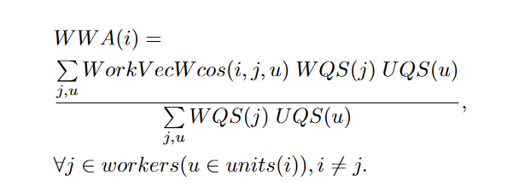
CROWD TRUTH
Worker-Worker Agreement (WWA)

Slide 19
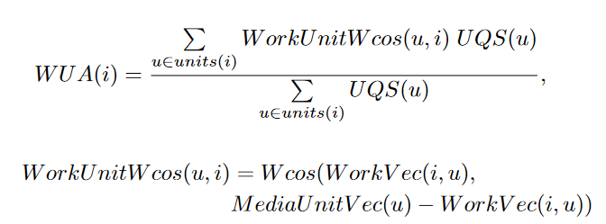
CROWD TRUTH
Worker-Media Unit Agreement (WUA)

Slide 20
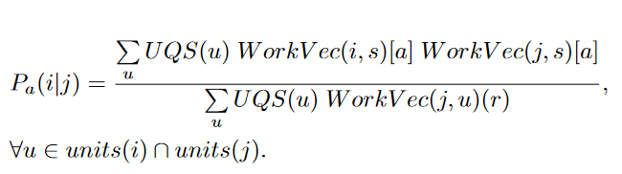
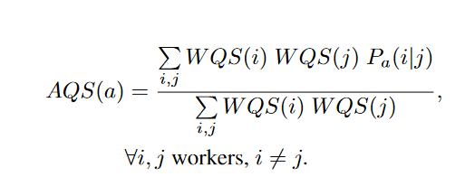
CROWD TRUTH
Annotation Quality Score (AQS)
the probability that if a worker j annotates a in a media unit, worker i will also annotate it

Slide 21
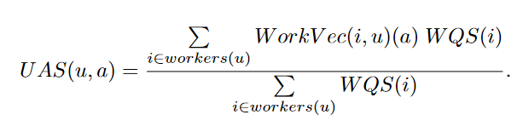
CROWD TRUTH
Media Unit - Annotation Score (UAS)

Slide 22
Experiments CIFAR10
S.No | Noise % | Accuracy
1 | 0% | 82.9 %
2 | 10% | 78.21%
3 | 20% | 75.55%
4 | 30% | 73.25%
5 | 40% | 69.66%
6 | 50% | 66.28%

Slide 23
Experiments CIFAR10
S.No | Noise % | Accuracy
1 | 0% | 98.71 %
2 | 10% | 98.2 %
3 | 20% | 97.25 %
4 | 30% | 97.89%
Model pretrained on imagenet dataset

Slide 24
Experiments CIFAR10
S.No | No.of Annotators | Noise Levels | Majority Vote Accuracy | Consensus Label Accuracy
0 | 3 | [0,0,0] | 100 | 100
1 | 3 | [0.05,0.05,0.05] | 99.52 | 99.98
2 | 3 | [0.1,0.1,0.1] | 97.93 | 99.83
3 | 3 | [0.6,0.7,0.3] | 56.31% | 93.78%
4 | 5 | [0.5,0.1,0.3,0.2,0.3] | 96.4 | 99.03
5

Slide 25

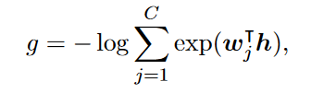


Contrastive Out-of-Distribution Detection for Pretrained Transformers
Scoring Functions:
Maximum Softmax Probability
Energy Score
Mahalanobis Distance
Cosine Similarity

Slide 26
 | Mahalanobis Score |  | Softmax Maximum Probability |  | Cosine Score |  | Energy Score
Row Labels | Average | StdDev | Average | StdDev | Average | StdDev | Average | StdDev
CIFAR 100 (0) | 27.519732 | 10.0412551 | 0.925774897 | 0.136719352 | 0.953917918 | 0.0554358 | 8.54034689 | 0.78548264
CIFAR 10 (1) | 61.145906 | 20.7801527 | 0.51119996 | 0.352829901 | 0.720127489 | 0.1860064 | 6.25914108 | 1.37716787
MIXUP (2) | 40.608606 | 18.8573616 | 0.779377654 | 0.306613882 | 0.868609875 | 0.1443585 | 7.55314231 | 1.45713847
Grand Total | 38.753196 | 21.4659311 | 0.787475283 | 0.303449361 | 0.875890697 | 0.1601328 | 7.77696071 | 1.48256389

Slide 27
CIFAR 100 Test Accuracy : 90.70%
 | Standard MB AUROC | Relative MB AUROC | SMP AUROC
CIFAR100 vs CIFAR10 | 0.9370 | 0.9214 | 0.8839
CIFAR100 vs FMNIST | 0.9804 | 0.9562 | 0.9458

Slide 32
Using uncertainty score of a model in place of w_{m.}
Rely on model prediction if the uncertainty is within threshold. Otherwise take weighted average of annotators consensus label.

Slide 35

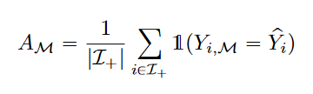
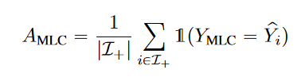
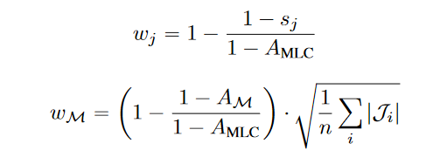
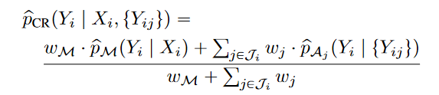
CROWDLAB – Consensus label

Slide 36
CROWDLAB -Annotator Quality Score:

Slide 37
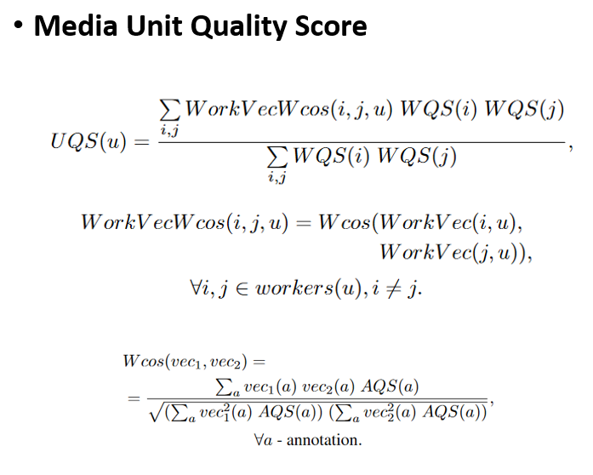
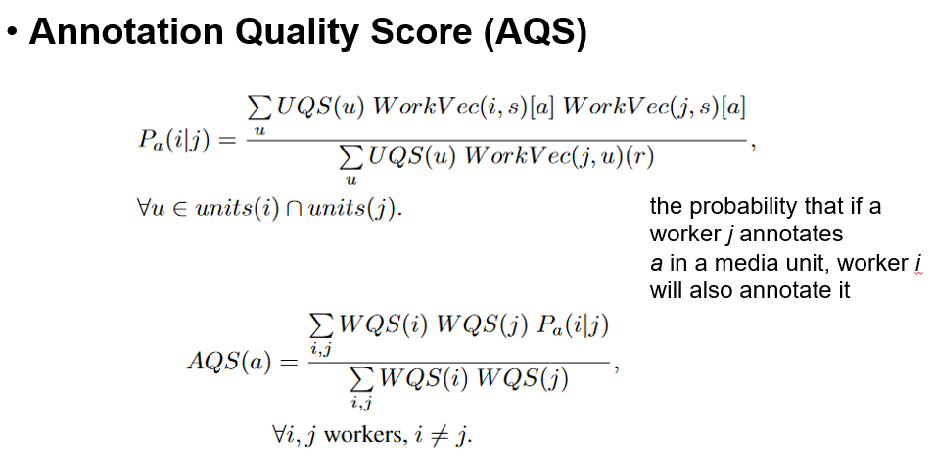
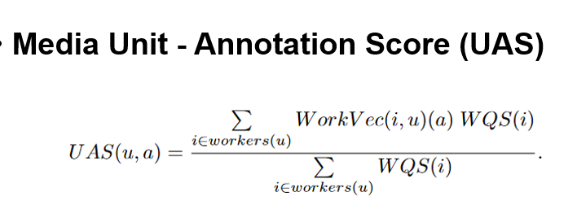
CROWDTRUTH
Worker Quality score
WQS(i) = WWA(i) * WUA(i)

Slide 38
Using uncertainty score of a model in place of w_{m.}
Rely on model prediction if the uncertainty is within threshold. Otherwise take weighted average of annotators consensus label.

